Slide 1
Critical Thinking, Data Analytics, Big Data and Management Accounting
Ann C. Dzuranin, Ph.D.

Slide 2
Agenda
What is Big Data?
Why is data analytics important for accountants?
What skills do employers want?
How can we prepare our students for a data driven world?
How can we teach critical thinking skills?
How can we integrate the critical thinking skills, accounting competencies, and technology skills into our existing curriculum?
An example using publicly available data.
Conclusion

Slide 3
What is “Big Data”

Slide 4
What is “Big Data”?
IBM Analytics Description*:
Every day, we create 2.5 quintillion bytes of data — so much that 90% of the data in the world today has been created in the last two years alone.
This data comes from everywhere: sensors used to gather climate information, posts to social media sites, digital pictures and videos, purchase transaction records, and cell phone GPS signals to name a few.
IBM Infographic
*(Source: http://www-01.ibm.com/software/data/bigdata/what-is-big-data.html)

Slide 5
What is Business/Data Analytics?
Extensive and systematic use of data, statistical and quantitative analysis, exploratory and predictive analysis, and fact-based management to drive business decisions and actions. (Davenport, 2006, HBR)

Slide 6
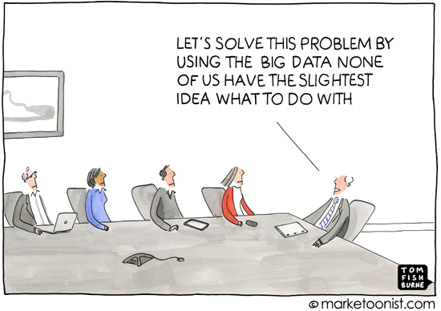
Why cover data analytics?

Slide 7
Data vs. Big Data
Accountants need to know how to conduct data analytics regardless of whether it is “Big”.
Data can tell us what has happened, Big Data can often help explain why.
Accountants need to embrace both.

Slide 8
Why Accounting Curriculum Should Include Data Analytics:
40 % projected growth in global data generated per year.
1.5 million more data-savvy managers are needed to take full advantage of big data in the U.S. *
Organizations create and collect massive amounts of data as result of their day-to-day operations.
Big Data represents an important asset for the organization.
Big data presents both opportunities and challenges for accounting professionals
*McKinsey Global Institute

Slide 9
Why Accounting Curriculum Should Include Data Analytics:
Accounting professionals are expected to know how data is created, collected, stored, and accessed.
As the custodians of the organization’s assets accountants are expected to understand and implement controls over the storage and use of the organization’s data.

Slide 10
Why Accounting Curriculum Should Include Data Analytics:
As business professionals we are expected to know how to use this vast source of data to make better business decisions and identify potential risks.
Understanding how to use data to formulate and solve business problems provides an opportunity for the accounting professional to become a forward thinking strategic partner in the organization.

Slide 11
What would employers love to have?
An employee with the following skills:
Ability to code and understand big data technology structures
Ability to construct experiments, gather and analyze data, make evidence-based decisions
Strong communication skills
Strong quantitative skills in statistical analysis, visual analytics, machine learning, and ability to analyze unstructured data
Business expertise – a good sense of where to apply analytics and big data

Slide 12
So in other words…
They are looking for:

Slide 13
What do employers really want?
Graduates that can think critically
Identify issues, develop questions
Determine appropriate analyses
Interpret results
Graduates that are data literate
Know what data is available, how it is stored, where it is stored, how to access it.
Understand data science and be able to bridge the gap between technical knowledge and business knowledge.
Graduates that can communicate findings

Slide 14
So where do we begin?
Help students develop and practice critical thinking skills
Provide experiential learning opportunities of working with data
Help students learn/reinforce quantitative skills and technology skills

Slide 15
Step 1: Critical Thinking

Slide 16
Critical Thinking
A definition:
“Critical thinking is that mode of thinking – about any subject, content, or problem – in which the thinker improves the quality of his or her thinking by skillfully analyzing, assessing, and reconstructing it. “
“It entails effective communication and problem solving abilities”
Paul, R., & Elder, L. (2006). Critical thinking: Learn the tools the best thinkers use (Concise ed.). Upper Saddle River, N.J.: Pearson/Prentice Hall.

Slide 17
The first step is identifying the question..

Slide 18
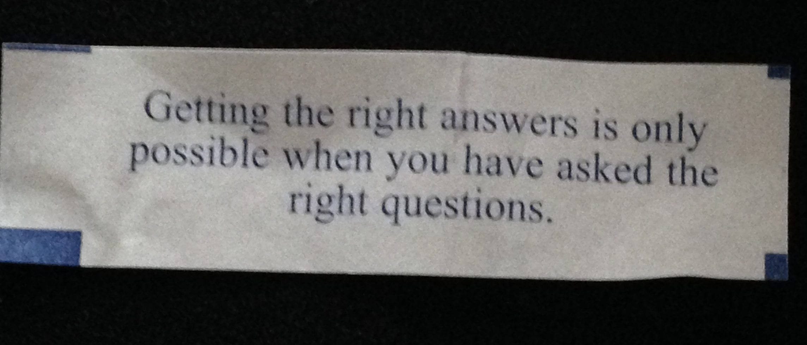
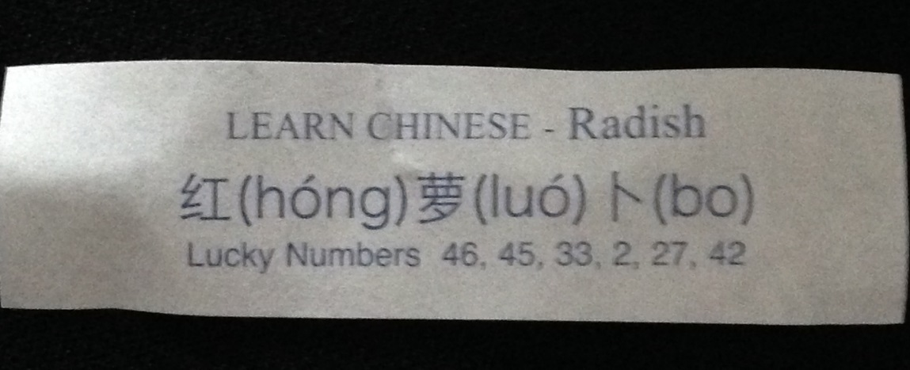
Asking Analytic Questions
“Getting the right answers is only possible when you have asked the right questions.”

Slide 19
Asking Essential Questions…
“The quality of our thinking is given in the quality of our questions.”¹
To be skilled at thinking we must be skilled at questioning.
Questions are “the keys to productive thinking, deep learning, and effective living.” ¹
¹Elder & Paul, (2010), “The Art of Asking Essential Questions”

Slide 20
Universal Structures of Thought
Paul, R., & Elder, L. (2006). Critical thinking: Learn the tools the best thinkers use (Concise ed.). Upper Saddle River, N.J.: Pearson/Prentice Hall.

Slide 21
Elements of Thought
https://www.criticalthinking.org/ctmodel/logic-model1.htm

Slide 22
Intellectual Standards
Use these standards explicitly in your thinking:
Clarity
Accuracy
Precision
Relevance
Depth
Breadth
Logic
Significance
Fairness

Slide 23
Clarity
Understandable, the meaning can be grasped
Could you elaborate further?
Could you give me an example?
Could you illustrate what you mean?

Slide 24
Accuracy
Free from errors or distortions, true
How could we check on that?
How could we find out if that is true?
How could we verify or test that?

Slide 25
Precision
Exact to the level of detail necessary
Could you be more specific?
Could you give me more details?
Could you be more exact?

Slide 26
Relevance
Relating to the matter at hand
How does that relate to the problem?
How does that bear on the question?
How does that help us with the issue?

Slide 27
Depth
Containing complexities and multiple interrelationships
What factors make this a difficult problem?
What are some of the complexities of this question?
What are some of the difficulties we need to deal with?

Slide 28
Breadth
Encompassing multiple viewpoints
Do we need to look at this from another perspective?
Do we need to consider another point of view?
Do we need to look at this in other ways?

Slide 29
Logic
The parts make sense together, no contradictions
Does all this make sense together?
Does your first paragraph fit with your last?
Does what you say follow the evidence?

Slide 30
Significance
Focusing on the important, not trivial
Is this the most important problem to consider?
Is this the central idea to focus on?
Which of these facts are most important?

Slide 31
Fairness
Justifiable, not self-serving or one-sided
Do I have any vested interest in this issue?
Am I sympathetically representing the viewpoints of others?

Slide 32
Putting it all together…

Slide 33
Step 2: Experience working with data
Do you need “Big Data”?

Slide 34
Where do I get data?
https://www.data.gov/open-gov/
http://ohiotreasurer.gov/Transparency/Ohios-Online-Checkbook
https://data.cityofchicago.org/
https://data.cincinnati-oh.gov/Fiscal-Sustainability-Strategic-Investment/City-of-Cincinnati-Vendor-Payments/cp9c-mn9x

Slide 35
https://www.data.gov/open-gov/
Excel File

Slide 36
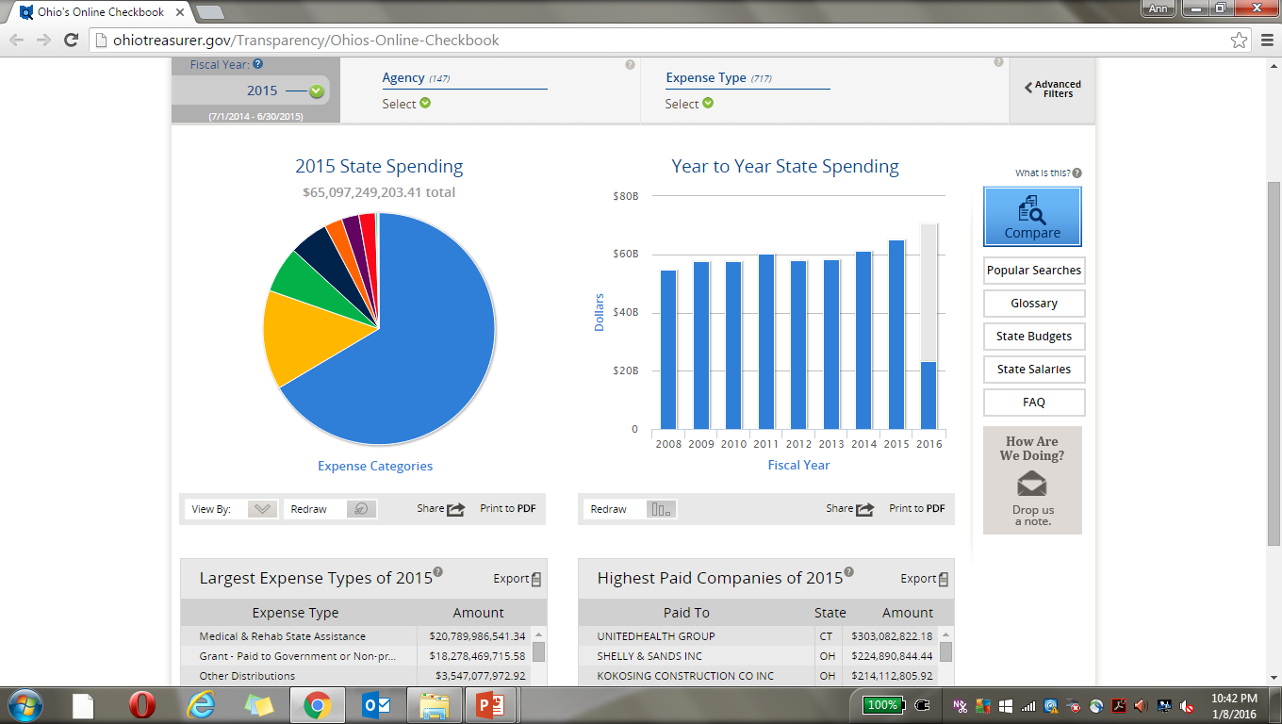

Slide 37
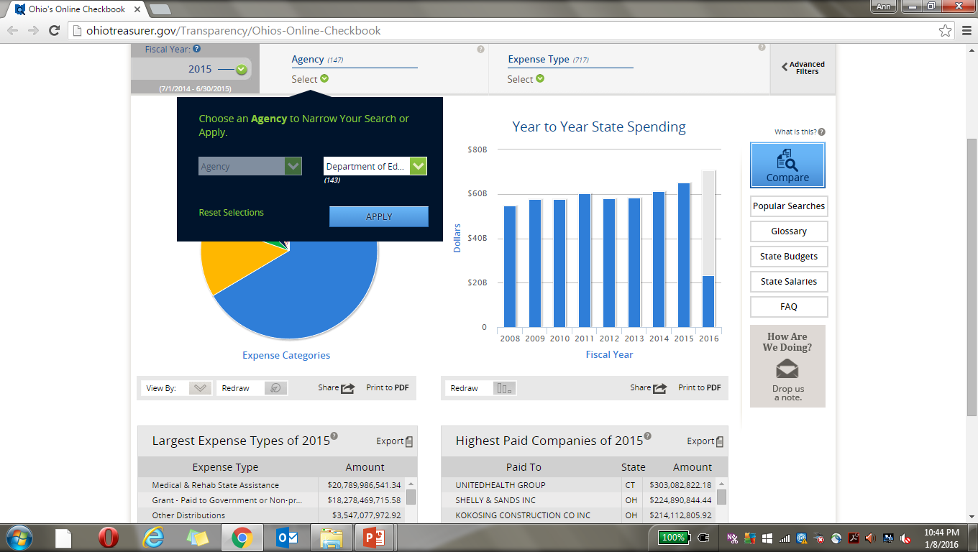

Slide 38
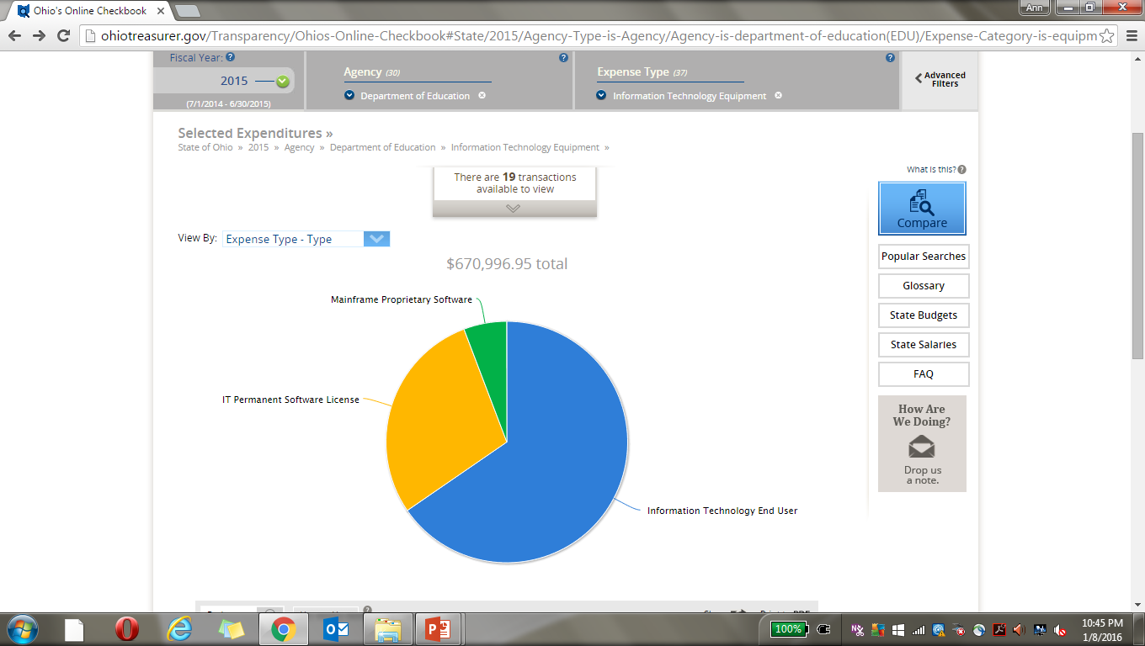

Slide 39
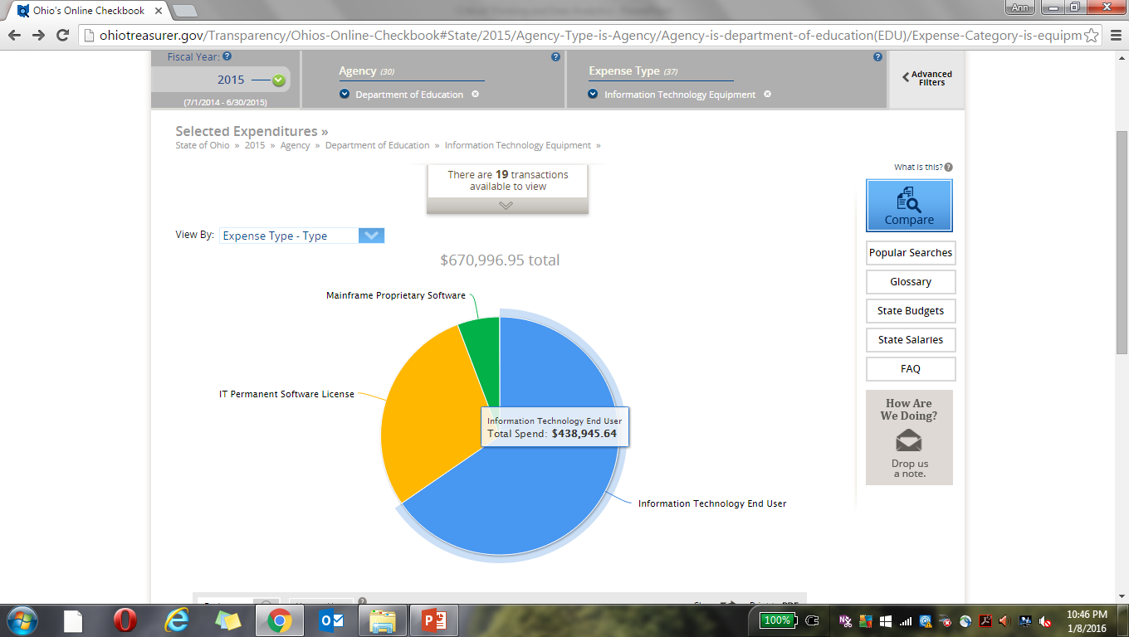

Slide 40
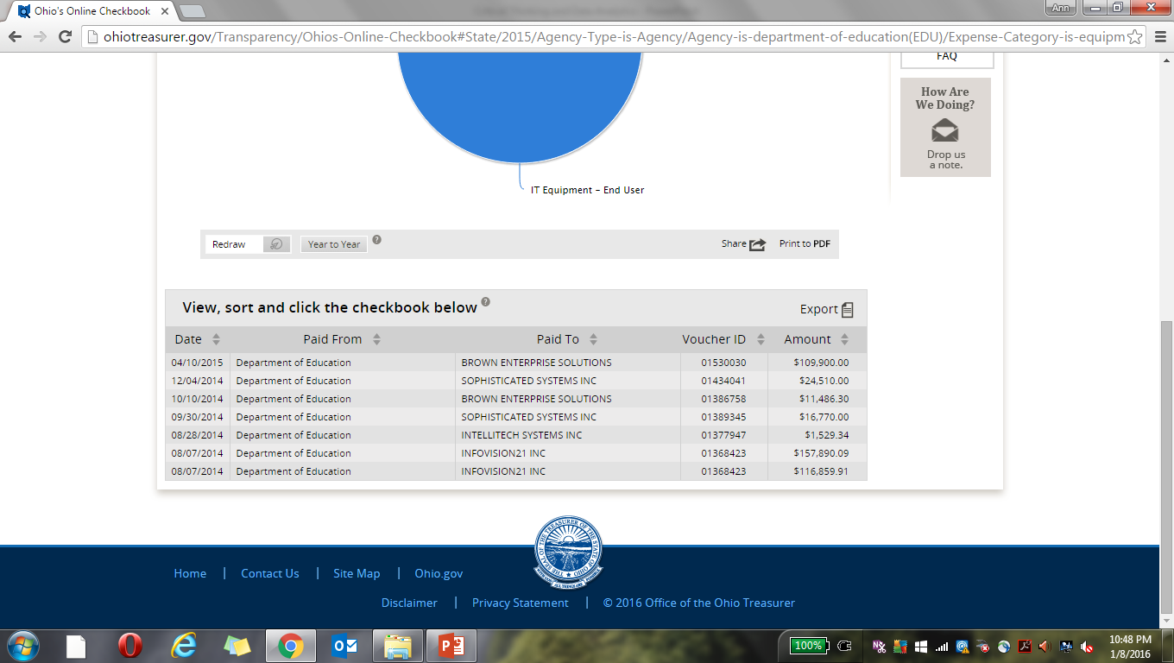

Slide 41
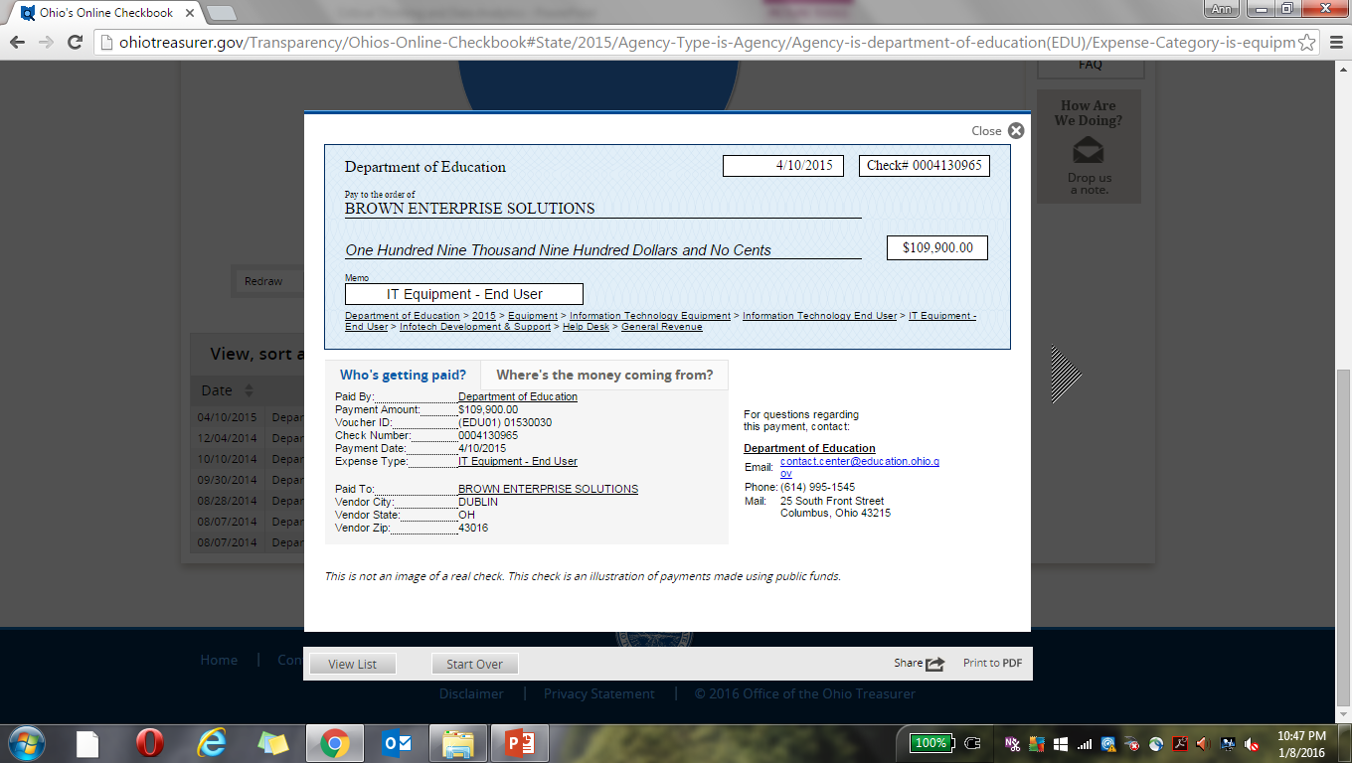

Slide 42
Step 3: Quantitative and Technology Skill Development
Statistics
Descriptive
Most common and most widely understood analytics
Categorize, characterize, consolidate and classify data to convert it to useful information.
Answer questions such as:
What business unit has the lowest productivity?
How much did we sell in each region?
Predictive
Seeks to predict the future by examining historical data.
Helps to detect patterns and trends in data.
Addresses questions such as:
What will happen if demand falls by 10%?
What do we expect to pay for maintenance for the next 6 months?

Slide 43
Step 3 continued
Statistics
Prescriptive
Uses optimization to identify the best alternatives to minimize or maximize some objective.
Addresses questions such as:
How much should we produce to maximize profit?
What is the best way to ship our goods to minimize costs?
Technology
Excel
Tableau (or any data visualization)
SAS/SPSS etc.

Slide 44
Where do I get software and support?
Tableau
http://www.tableau.com/academic
IBM Academic Initiative
http://www-304.ibm.com/ibm/university/academic/pub/page/membership
SAS GLOBAL ACADEMIC PROGRAM
http://support.sas.com/learn/ap/student/index.html

Slide 45
Example
Issue:
Overtime and supplemental pay for the city of Chicago totaled more than $123 million in 2012, $197 million in 2013, and $242 million in 2014.
As a member of the budget and forecasting team you need to estimate the budget for supplemental pay for 2015.
You can find the data for the prior years Overtime and Supplemental Pay, as well as other potentially useful data, on the city’s website: https://data.cityofchicago.org/

Slide 47
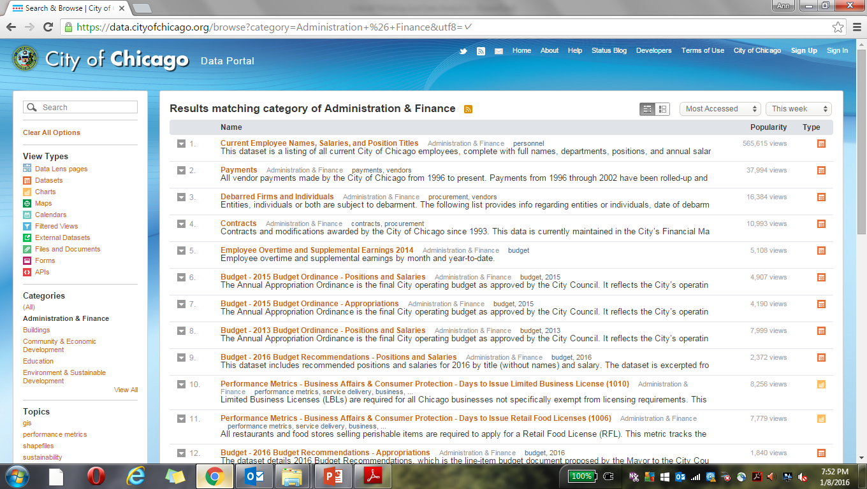

Slide 48
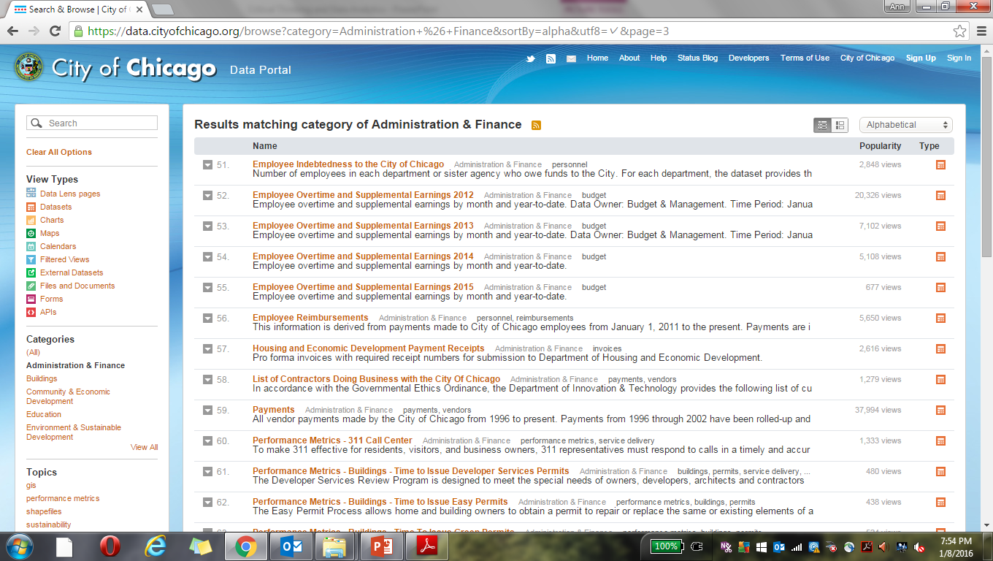

Slide 49
Download the files in CSV format
2012
24,271 rows of data!

Slide 50
Apply the Elements of Thought and Reasoning to determine:
Purpose
Question
Assumptions
Point of View
Data ,Information and Evidence
Concept
Inferences
Implications

Slide 51
Question at issue
What is the problem or issue?
Expense has been rising each year – why?
What can we expect next year?

Slide 52
Information
What data, facts, observations or experiences will help to address the question/problem?
2012 – 2015 expenses by department
Expense drivers

Slide 53
Concept
What are the key concepts? Explain them clearly
Consider alternative concepts
Make sure you are using the concepts with precision
Develop a regression model to predict 2016 expenses by department.

Slide 54
Inferences
Infer only what the evidence implies.
Check inferences for their consistency with each other.
Identify assumptions underlying your inferences.

Slide 55
Example using the City of Chicago data
Tableau example

Slide 56
What if I am afraid of technology?

Slide 57
Apply the critical thinking concepts…
Use the cases provided on the AAA commons from the Accounting IS Big Data conference.
Have students go through the process of identifying the problem/question, the data they would want to collect , and how they would analyze it.
For Example…

Slide 58
Discussion cases:

Slide 59
Cases related to management accounting topics:
Focus Area #1 – Sales Planning
Focus Area #3 – Reduce Labor Expense
Focus Area #9 – Sensor driven data to predict revenues & reduce costs
Focus Area # 16 – Using Big Data to Reduce Operating Costs

Slide 60
Conclusion
“The emerging fields of business analytics and business intelligence provide opportunities for accountants to become involved in a wider variety of business decisions, including those directly related to strategy implementation.” (Lawson, et al. 2014)

Slide 61
Conclusion
Three of the five foundational competencies are addressed in the previous example
Quantitative Methods –
regression analysis
Analytical thinking and problem solving –
Identifying key issues, data required, data visualization, inferences
Technology
Statistics software
Data visualization software
Excel

Slide 62
Conclusion
Accounting Competencies:
Planning and Analysis
Information Systems
Gathering, validating, and analyzing data

Slide 63
References
Paul, R., & Elder, L. (2006). Critical thinking: Learn the tools the best thinkers use (Concise ed.). Upper Saddle River, N.J.: Pearson/Prentice Hall.
www.criticalthinking.org
Lawson et al., 2014. Focusing Accounting Curricula on Students’ Long-Run Careers: Recommendations for an Integrated Competency-Based Framework for Accounting Education. Issues in Accounting Education

Slide 65
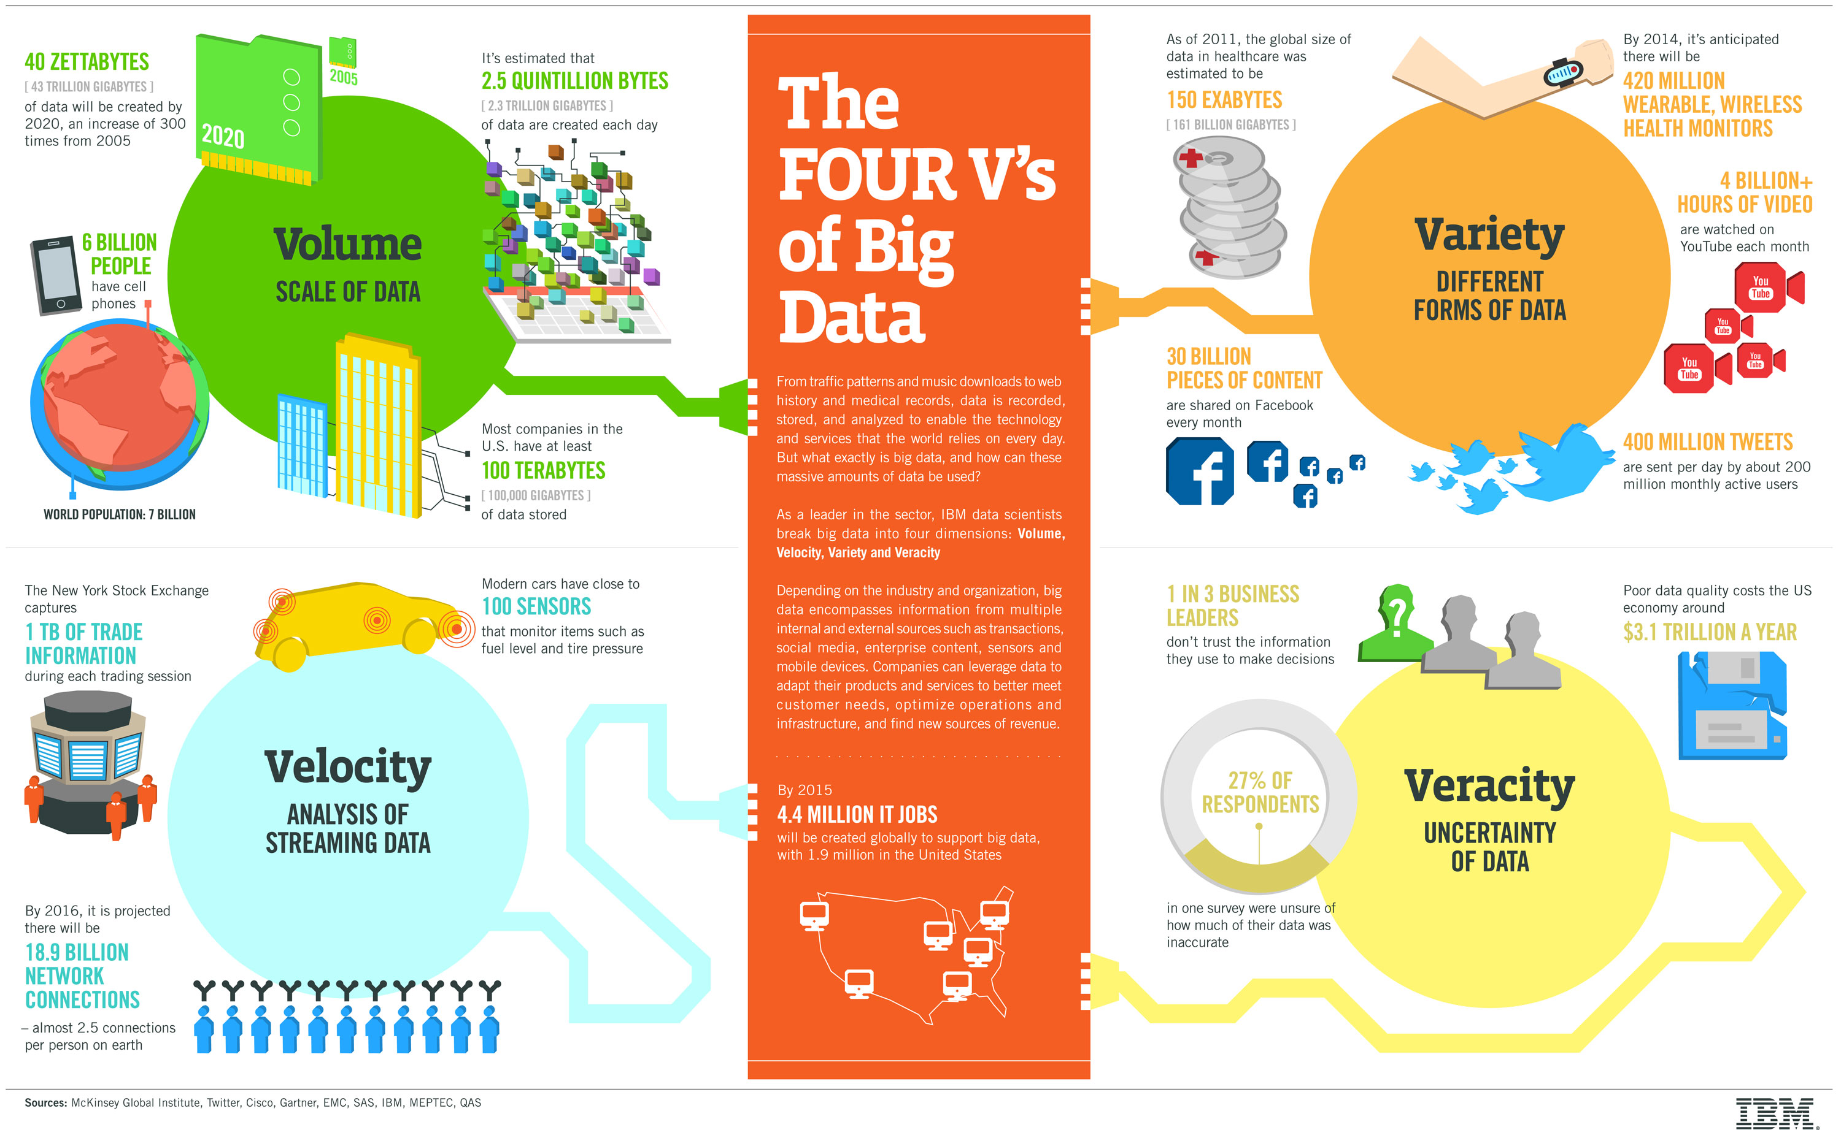
IBM Big Data Infographic:
Back
http://www.ibmbigdatahub.com/sites/default/files/infographic_file/4-Vs-of-big-data.jpg?cm_mc_uid=93077432826114520148395&cm_mc_sid_50200000=1452014839

